Slide 1
Review of previous classes
1. Nanotechnology in upward motion: next future of science and technology is nanotechnology
2. Constructive - Destructive interference by thin films
3. Non-Reflective Surfaces
4. Super-Hydro-Phobicity
5. Self-Cleaning
Nano in Histroy
The Localized Surface Plasmon Resonance
DICHROISM
Development of nanoscience and technology
Diversity of nano field
Surface to volume atoms of Cuboctahedral system
M(K) = (1/3)*(10K³+15K²+11K+3), K = No. of shell
N_{K} =10K² + 2, Every shell contains number of shell
SIZE EFFECT
Quantum Effect
To-Down Method of Preparation
Ball mill, Thermal, Arc discharge, Laser ablation etc.
LITHOGRAPHIC METHOD
Bottom-UP method
HOW TO REALIZE THE NANOPARTICLE ?
TEM, SEM, AFM, STM
XRD, OPTICAL AND THERMAL METHODS

Slide 2
MATERIALS
AMOURPHOUS
CRYSTALLINE
It can also be in two different form
SUPERSTRUCTURE
QUASICRYSTAL

Slide 3
Quasicrystal
Crystalline
Crystal
Crystal
Crystal
Crystal
Super structure

Slide 4
Triclinic
Monoclinic
Orthorhombic
Tetragonal
Cubic
Hexagonal
Rhombohedral
α ≠ β ≠ γ ≠ 90⁰ a ≠ b ≠ c
α (ZY) β(ZX) γ(XY)
α = γ = 90⁰ ≠ β a ≠ b ≠ c
α = β = γ= 90⁰ a ≠ b ≠ c
α = β = γ=90⁰ a = b ≠ c
α = β = γ= 90⁰ a = b = c
α = β = 90⁰ γ=120⁰ a = b = c
α = β = γ ≠ 90⁰ a = b = c
P
P, C
P, C, F, I
P, I
P, F, I
P
R
1
2
4
2
3
1
1

Slide 5
Point Group:
a point group is a group of geometric symmetries leaving a point fixed.
32 Point groups
Triclinic
Monoclinic
Orthorhombic
Tetragonal
Cubic
Hexagonal
Rhombohedral
1, 1
2, m, 2/m
222, 2mm, mmm
4, 4, 4/m
422,4mm,4m2,4/m mm
23, m3
432, 43m,m3m
6, 6, 6/m
62, 6mm,6m2, 6/m mm
3, 3
32,3m,3m
1
2/m
mmm
4/m
4/m mm
m3
m3m
6/m
6/m mm
3
3m
In all casees where the incident X-ray wavelength is not near the x-ray absorption edge of the material of the crystal, x-ray diffraction automattically introduces a centre of symmetry. i.e. It can not distinguish between reflection h k l and h k l. It is not possible to find out whether the crystal is centrosymmetrical or not. Hence 32 crystal classes reduce to 11 lau group.
Space group: Lattice type + Point group (230 space groups)

Slide 6
XRD
The Nobel Prize in Physics 1901 was received by Wilhelm Conrad Röntgen for his great invention of x- ray.
The first X-ray diffraction experiments on a single crystal was carried out in 1912 (Friedrich, Knipping and von Laue)
Now a days X-ray crystallography has been of major importance in natural sciences and especially in crystals.
X-ray diffraction provided the ideal means to understand structures of crystalline matters on an atomic scale.

Slide 7
Like visible light an X-ray beam is an electromagnetic wave characterized by an electric field vector E which is perpendicular to the direction of propagation and a magnetic field vector H which in turn is perpendicular both to E and the direction of propagation.
The spectra of visible light comprises the range from 4000 to 7000Å , while X-rays have typically wavelengths between 0.1 to 10Å.
Due to the fact that X-ray wavelengths are comparable to the interatomic distances within a crystalline material one observes characteristic interactions between the X-rays and the ordered array of electrons in the crystal structure. These interactions make X-rays the most important source for the investigation of crystal structures.

Slide 8
X-rays are produced when electrons are accelerated and collide with a target
Bremsstrahlung x-rays
Characteristic x-rays
X-rays are sometimes characterized by the generating voltage
0.1-20 kV soft x-rays
20-120 kV diagnostic x-rays
120-300 kV orthovoltage x-rays
300 kV – 1 MV intermediate energy x-rays
> 1MV megavoltage x-rays

Slide 9
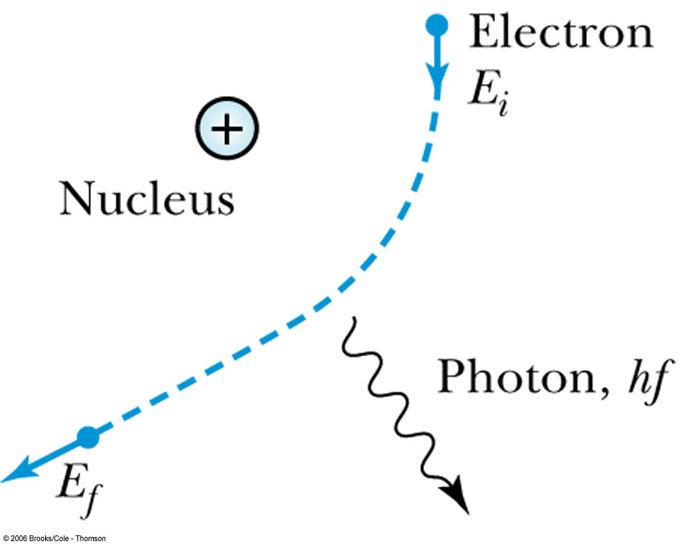
Bremsstrahlung x-rays occur when electrons are (de)accelerated in the Coulomb field of a nucleus

Slide 10
The power radiated from an accelerating charge is given by Larmor’s equation
In the case of an electron in the Coulomb field of a nucleus

Slide 11
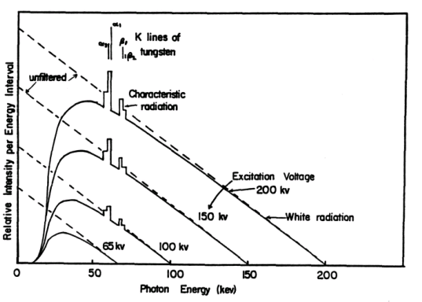
The probability of bremsstrahlung goes as Z², hence high Z targets are more effective than low Z
The energy of the x-rays varies from zero to the maximum kinetic energy of the electron

Slide 12
Characteristic x-rays
After excitation, ions with a vacancy in their inner shell can de-excite
Radiatively through x-ray fluorescence
Non-radiatively through the emission of Auger electrons

Slide 13
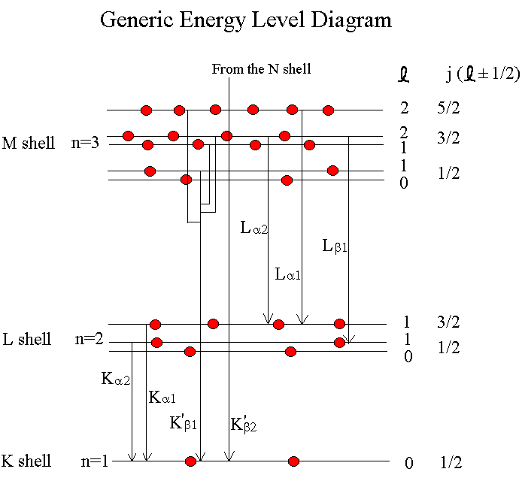
Thus an x-ray spectrum will also show characteristic x-rays arising from L to K and M to K transitions after ionization of a K electron
Usually transitions to higher shells absorbed by the filtration or are not x-rays

Slide 14
Wavelengths in Nanometer Units of Characteristic Emission Lines for Selected Elements.
Element K_{α1} K_{α2} K_{β1} Lα1
Cr 0.228962 0.229351 0.228480 ****
Cu 0.154051 0.1544330 0.139217 1.3357
Mo 0.070926 0.071354 0.063225 0.54062
W 0.020899 0.021381 0.018436 0.14763

Slide 15
X-rays by a lattice plane was suggested by W. L. Bragg in 1912 and is known as the Bragg-equation
2d_{h,k,l}sinθ = nλ
λ = wavelengths of the X-rays,
d_{h,k,l} = Interplanar spacing of parallel lattice planes
θ = Diffraction angle

Slide 16
TECHNIQUES IN THE XRD
• X-ray Powder Diffraction (XRPD)
• Single Crystal Diffraction (SCD)
• Grazing Incidence Angle Diffraction (GIXD)
• X-ray Reflectivity (XRR)
• Small Angle X-ray Scattering (SAXS)

Slide 17
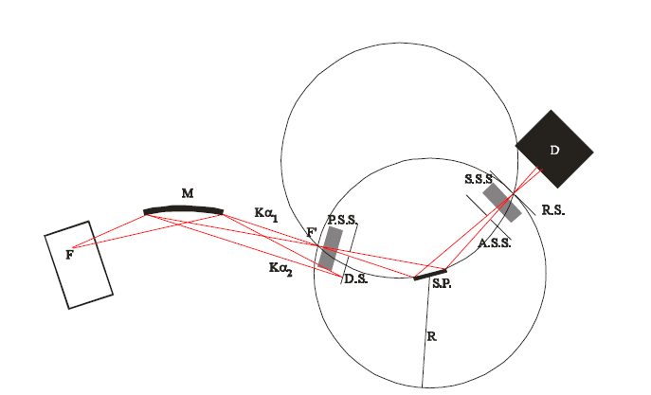
Bragg-Brentano laboratory diffractometer in reflection geometry with bent (focusing) primary beam monochromator M, primary soller slit P.S.S., divergence slit D.S., scattering slit A.S.S., secondary soller slit S.S.S and receiving slit R.S.

Slide 18
X-Ray Powder Diffraction (XRPD)
• More appropriately called polycrystalline X-ray diffraction, because it
can also be used for sintered samples, metal foils, coatings and
films, finished parts, etc.
• Used to determine:
– phase composition (commonly called phase ID)- what phases are
present?
– quantitative phase analysis- how much of each phase is present?
– unit cell lattice parameters
– crystal structure
– average crystallite size of nanocrystalline samples
– crystallite microstrain
– texture
– residual stress (really residual strain)
– in-situ diffraction (from 11 K to 1200C in air, vacuum, or inert gas)

Slide 19
Crystal
Schematic of difference between the diffraction patterns of various phases
Intensity →
0
90
180
Diffraction angle (2θ) →
Monoatomic gas
Intensity →
Diffraction angle (2θ) →
Diffraction angle (2θ) →
Liquid / Amorphous solid
Intensity →
0
90
180
0
90
180

Slide 21
XRD Line Broadening
Unresolved α₁ , α₂ peaks • Non-monochromaticity of the source (finite width of α peak)
Imperfect focusing
Instrumental
B_{i}
Crystallite size
In the vicinity of θ_{B}
B_{c}
Strain
‘Residual Strain’ arising from dislocations, coherent precipitates etc. leading to broadening
B_{s}
Stacking fault
In principle every defect contributes to some broadening
Other defects

Slide 22
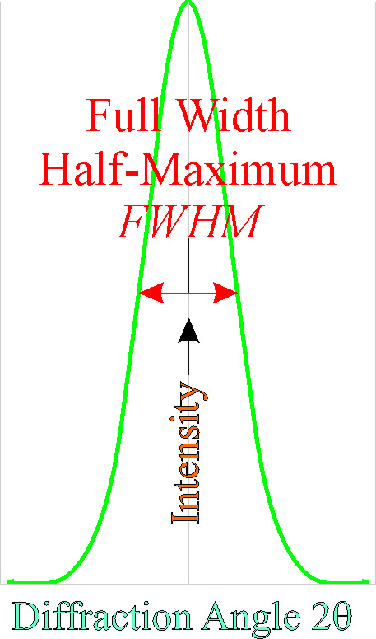
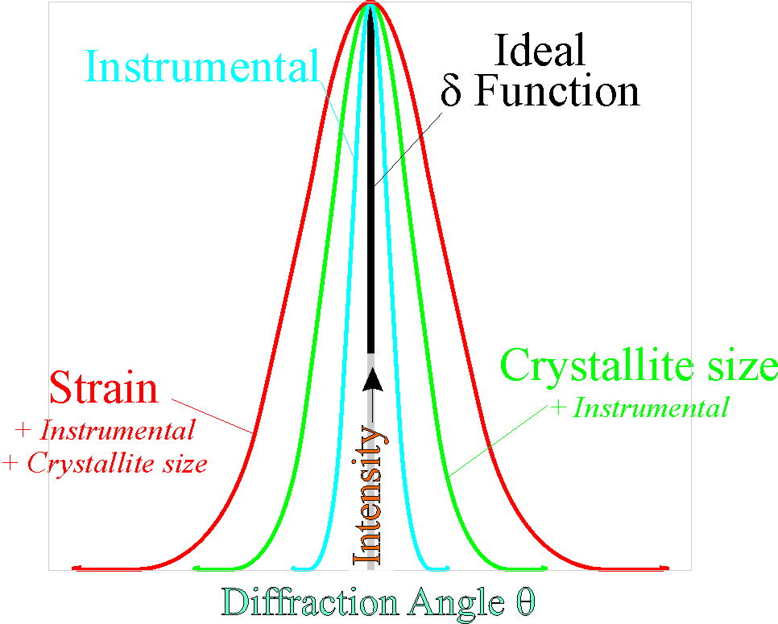

Slide 23
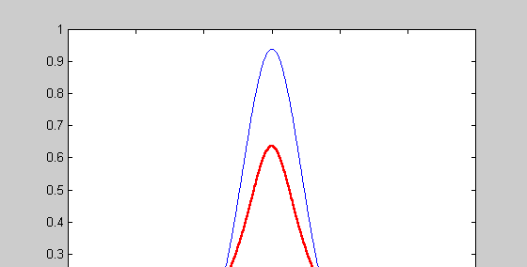
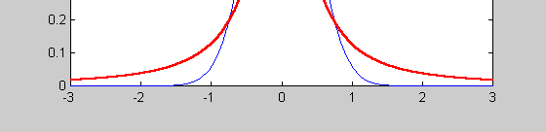
FWMH² = (U+D²_{ST)}( tan²θ) +V (tanθ) +W+IG/cos²θ
Where U, V and W are the usual peak shape parameters, IG is a measure of the isotropic size effect, D_{ST} =coefficient related to strain.
The (pseudo-)Voigt function
Gaussian
Lorentzian

Slide 24
Scherrer’s formula
For Gaussian line profiles and cubic crystals
λ → Wavelength
L → Average crystallite size (⊥ to surface of specimen)
k → 0.94 [k ∈ (0.89, 1.39)], only for circular grain ~ 1 (the accuracy of the method is only 10%)

Slide 25
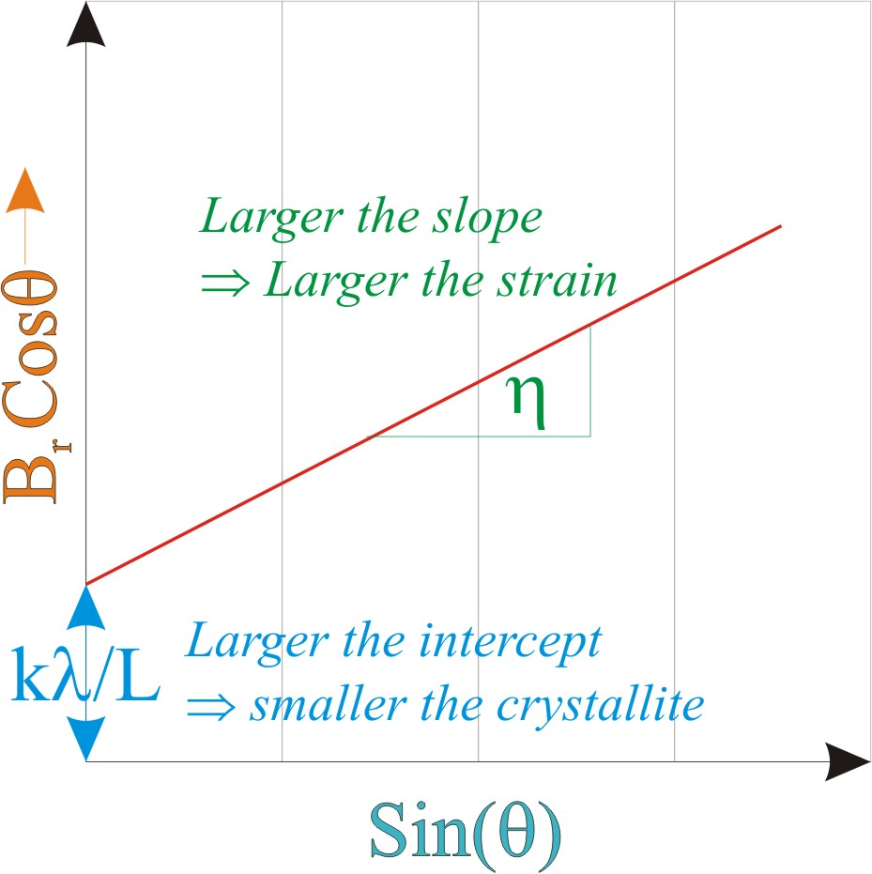
Separating crystallite size broadening and strain broadening
Strain broadening
η → Strain in the material
Plot of [B_{r} Cosθ] vs [Sinθ]

Slide 26
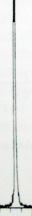

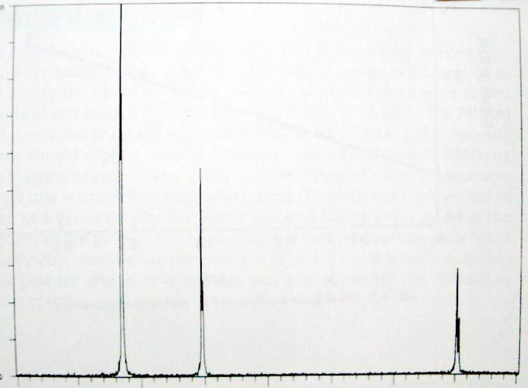
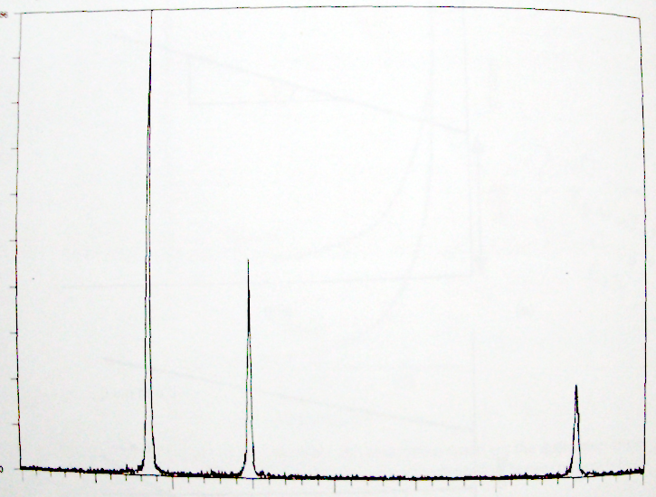
Example of a calculation
Sample: Annealed Al Radiation: Cu kα (λ = 1.54 Å)
Intensity →
Sample: Cold-worked Al Radiation: Cu kα (λ = 1.54 Å)
2θ →
40
60
Intensity →
2θ →
40
60
X-Ray Diffraction: A Practical Approach, C. Suryanarayana & M. Grant Norton, Plenum Press, New York (1998)

Slide 27
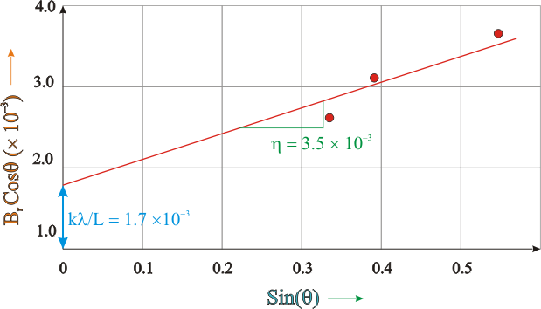

Slide 29
(a) Typical Williamson-Hall plot of sample S1 (CoFe₂O₄: Citrate method) and (b) S2 (CoFe₂O₄: co-precipitation method) annealed at 600ºC. 1% error bar has shown for each data.

Slide 30
Average crystallite size (nm) calculated by Scherrer’s, Williamson-Hall and Rietveld methods for the samples S1 and S2 annealed at different annealing temperatures.
 | S1 (CoFe₂O₄: citrate method) |  |  | S2 (CoFe₂O₄: co-precipitation method)
Annealing temperature | Scherrer’s method | Williamson-Hall method | Rietveld method | Scherrer’s method | Williamson-Hall method | Rietveld method
200⁰C | 9.1 | 8.1 | 6.2 | 12.1 | 11.2 | 9.4
400⁰C | 12.2 | 11.1 | 9.3 | 14.3 | 13.1 | 11.1
600⁰C | 38.3 | 37.1 | 35.4 | 17.4 | 16.3 | 15.3
800⁰C | 50.1 | 49.2 | 48.2 | 36.1 | 35.1 | 33.2

Slide 31
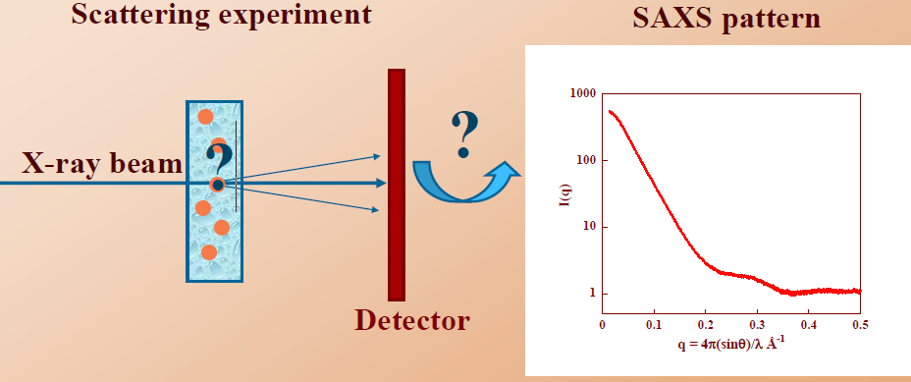
X-ray Scattering by assemblies of electrons
Fourier transform
Convolution Product
X-ray scattering by particles in solution.

Slide 32
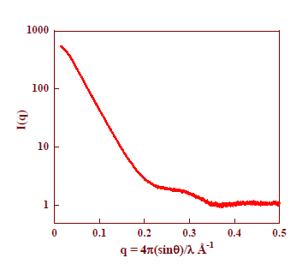

Slide 33
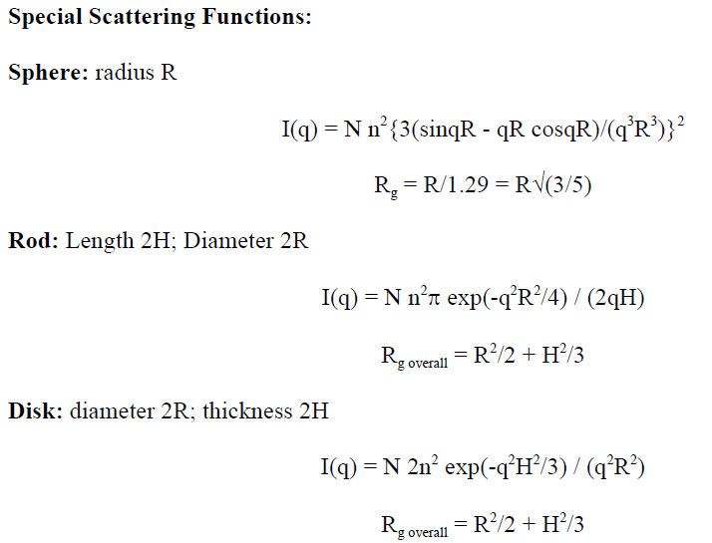
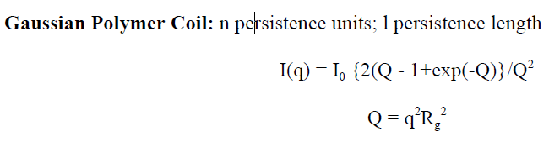
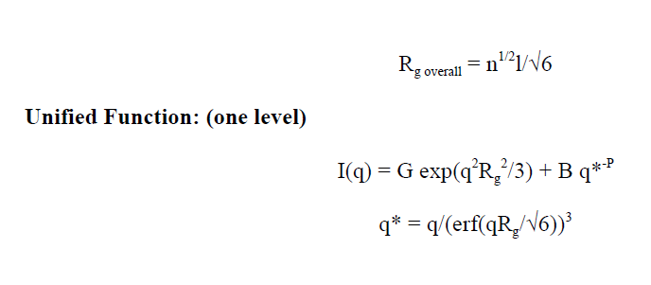
This is a generic function where G, R_{g}, P and B are defined according to local functions. For example, for a sphere, G = N n²; Rg = R/1.3; P = 4; B = 2p G S/V² = 9 G/(2 R⁴). (Sphere S = 4πR²; V = 4πR³/3)

Slide 34
What is Grazing Incidence Diffraction?
Grazing Incidence Diffraction for Thin Film Phase Analysis
X-ray radiation has a large penetration depth into any matter. Due to this property X-ray diffraction is not surface sensitive
Grazing Incidence Diffraction (GID) is the technique to overcome this restriction.
GID measurements are performed at very low incident angles to maximize the signal from the thin layers. This allows Phase analysis on very thin layers
Surface sensitivity down to nm scale
Depth profiling of the phase composition of layered samples Göbel Mirrors for incident and diffracted beam with enhanced sensitivity and shorter measurement times Crystallography of thin films

Slide 35
Why use GID?
It is sometimes very difficult to analyze thin films due to their small diffracting volumes, which result in low diffracted intensities compared to the substrate and background.
This combination of low diffracted signal and high background make it very difficult to identify the phases present.
Accordingly, special techniques must be used when analyzing thin films
The most common technique for analyzing films as thin as 10nm is to use a grazing incidence angle arrangement combined with a parallel beam geometry
By increasing the path length of the incident X-ray beam through the film, the intensity from the film can be increased so that conventional phase identification analysis can be run.

Slide 36
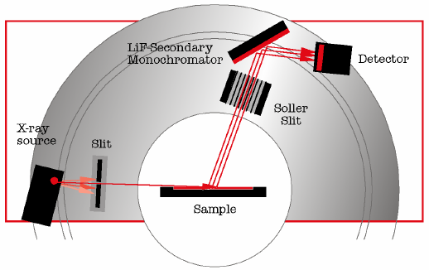

Slide 37
XRR Curve of a Periodic Multilayer
Total reflection ⇒ Electron density of the uppermost layer
Decrease of the reflected Intensity ⇒ interface roughness
Kiessig oscillations ⇒ thickness of the whole multilayer
Bragg-like peaks ⇒ thickness of the periodic motif
Extinction of the Bragg-like peaks ⇒ thickness of the individual layers in the multilayer system

Slide 38
Fe/Au Multilayers Experimental example
Fe/Au (27Å/23Å)x10
Si/Au(100Å)
Refined parameters
t (Fe) (27 ± 2) Å
t (Au) (23 ± 1) Å
Λ 50 Å
σ (Fe) 5 Å
σ (Au) 5 Å
ρ (Fe) (1.4 ± 0.2)
(Au) (0.9 ± 0.1)

Slide 39
X-ray reflectivity measurement
Calculation of the electron density, thickness and interface roughness for each particular layer
ρ t [Å] σ [Å]
0.68 19.6 5.8
0.93 236.5 34.0
1.09 14.1 2.7
1.00 5.0 2.7
1.00 2.8
Edge of TER
Mo
Mo
Kiessig oscillations (fringes)
Mo
W
Si
The surface must be smooth (mirror-like)

Slide 40
Thin Film analysis by X-Ray Scattering: Mario Birkholz
Elements Of X Ray Diffraction
Cullity, B. D
X-Ray Diffraction
BE Warren

Slide 41
SPECTROSCOPIC METHODS
Interaction of Electromagnetic Radiation (EM) with Mater: Spectrum
The interaction of radiation with matter assumes many forms. Molecular absorption of radiation is described by
UV-VIS Spectrophotometer: Absorption and Emission
Nanomaterial Interact with UV-> Many effects->
Plasmon oscillations on the surface of nanomaterials
Electron transfer cascades
Exciton Pairs in semiconductors (nano-TiO₂)
Particle size dependent fluorescence (semiconductor quantum dots)
Diameter dependent fluorescence (SWCNT)
Interference colors (porous alumina or titania thin films)
Beer-Lambart law

Slide 42
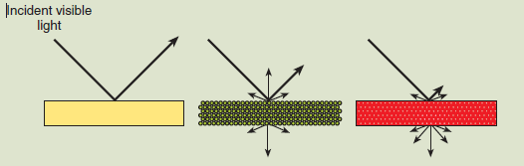
On the left, most of the visible light is reflected from a bulk metal surface. For example, the absorption–reflection of light is why bulk gold appears to have a yellow-reddish cluster. The middle image depicts how a thin particulate metal film (beyond the percolation threshold) scatters and reflects light. Some light is transmitted, some absorbed, and some reflected. The color of a thin film of Au may appear green if it is microgranular. On the right, a large fraction of the light is transmitted and scattered through a transparent
nanometal composite material. Absorption of light by nano gold yields many colors, depending on the size, shape, and orientation of the particle and the dielectric function of the surrounding medium.

Slide 43
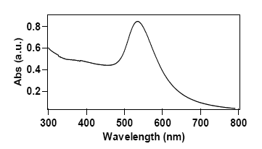
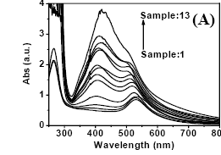
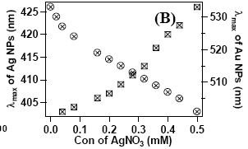
UV-visible spectrum of a typical Au NPs solution in the presence of AA in aqueous medium.
The UV-visible spectrum of AgNO₃ added Au NP solutions
Dependence of the absorption maxima (λ_{max}) of the Ag and Au NPs

Slide 44
Infrared and Raman Spectroscopy
Rely on Vibrational Energy: IR rely on asymmetrical (dipolar) vibration and Raman rely on Symmetrical (polarizable) vibrations. Complement each other
Raman spectroscopy is extremely inefficient: only 1 in 10⁸ photons are Raman scattered and typical scattering cross sections are ~10⁻³⁰ cm² (12 orders of magnitude less than
IR, 10⁻¹⁸ cm² and 15 less than fluorescence excitation,10⁻¹⁵cm² ).
Raman Spectroscopy Involves excitation with monochromatic laser light. Inelastically scattered light is the carrier wave for molecular vibrations— lower energy (Stokes lines) and higher energy (anti-Stokes lines). Usually Stokes lines are seen.
Conventional Raman spectroscopy
Resonant Raman spectroscopy
Surface Enhanced Raman spectroscopy
Surface Enhanced Resonant Raman spectroscopy

Slide 45
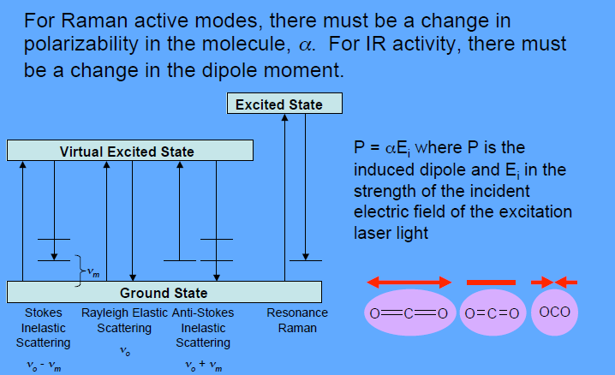

Slide 46
Surface Enhanced Raman SpectroscopySERS
Surface enhanced Raman spectroscopy is a true nanobased method.
The effect is related directly to nanoparticles or nanofacets (roughened) on a surface.
The plasmon electron cloud is responsible for most of the enhancement.
The plasmon exists on the surface of metals— nano (localized) and bulk (delocalized).
In nanometals, the surface plasmon is localized and the “degree” of interaction depends on the size, orientation and type of metal of the nanoparticle
• Electromagnetic theory of SERS is simple and can account for all SERS observations. It is wavelength specific
• Nanomaterials are required for SERS-active systems
• Some metals (noble metals) are good SERS substrates,others not
• The incredible signal enhancement (up to 10¹⁵) is due mostly to the electromagnetic properties of certain noble metal nanoparticles and allows for detection of single molecules
• Quantum theory not absolutely necessary to explain SERS effect

Slide 47
There are two modes of signal enhancement:
Electromagnetic Enhancement is linked to excitation of the surface plasmon. Plasmons are electromagnetic waves that propagate along the metal-dielectric interface as a result of the motion of electrons upon stimulation. When the analyte
molecule is placed within the proximity of the plasmon, it experiences an enhanced electric field and produces an enhanced scattering Raman field— leading to and enhanced analytical signal.
Chemical Enhancement involves charge transfer between the analyte chemisorbed species and the metal. New charge transfer pathways (new energy levels) are created that open the door for resonant SERS.

Slide 48
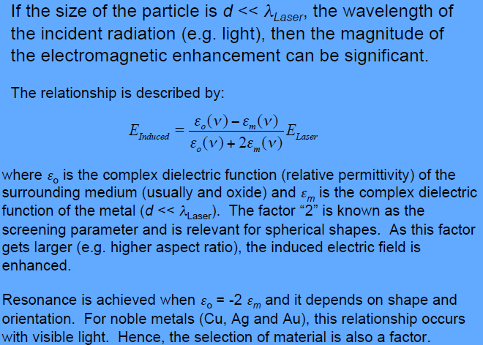

Slide 49
Raman intensity conforms to a ν⁴ dependence. In other words, the higher the frequency (shorter the wavelength), the better the intensity of the analytical signal.
In SERS, there is no ν⁴ dependence. Actually, lower frequency molecular vibrations are enhanced better than higher frequency vibrations due to the frequency dependence of the plasmon resonance.
Overall, SERS signals are relatively independent of the laser’s frequency and acquisition can occur at several different laser “colors”.
Bulk Surfaces:
Roughened surface (nano-facets) → 10³ to 10⁶ enhancement
Nanoparticles:
Enhancement tuned to size of nanoparticle
Enhancement tuned to shape of nanoparticle
Enhancement tuned to orientation of nanoparticle

Slide 50
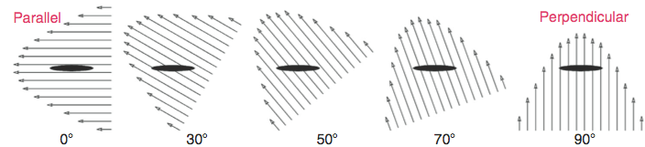
Case 1:
When the electric field of the light is aligned parallel to the long axis of the nanoparticle, its “hot spot” is maximized (e.g. the “lightning rod” effect). This leads to a maximized SERS effect. An analyte molecule that is chemisorbed onto this site will deliver a large SERS signal. A clear polymer embedded with nanoparticulate gold in this orientation will appear to be green.
Case 2:
When the short axis of the nanoparticle is aligned with the electric field, the SERS enhancement is minimized. A clear polymer embedded with such nanoparticulate gold with this orientation will appear to be red.

Slide 51
THERMODYNAMIC METHODS
• Thermal gravimetric analysis (TGA) → Δm
• Differential thermal analysis (DTA) → ΔT
• Differential scanning calorimetry (DSC) → ΔH
• Thermomechanical analysis (TMA) → Δ dimension
• Dynamic mechanical analysis (DMA) → damping
• Dilatometry → ΔV
Brunauer-Emmett-Teller (BET)

Slide 52
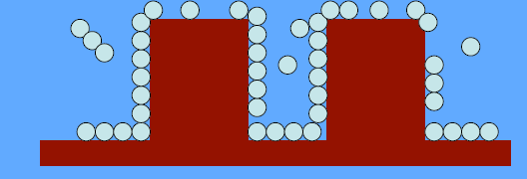
One tried and true analytical method grounded in traditional thermodynamics (and nanoscience) is the BET method to determine surface area and porosity. Gas sorption methods are applied to determine surface area, specific surface area, pore volume, pore size distribution and active sites. Adsorption is the accumulation of an adsorbate on a surface (the
adsorbent).
Physisorption is a non-specific process dominated by van der Waals forces, therefore, the heats of adsorption of generally small: ΔH_{ads} = 10 – 40 kJ·mol⁻¹ and the process occurs at low temperatures (77 K for N₂). Chemisorption involves the forming of chemical bonds (ΔH_{chem} = 100 – 400 kJ·mol⁻¹).
The level of adsorption depends on the temperature, the pressure, the interaction between the gas and the solid and the total amount of surface area.
There are many kinds of adsorption isotherms. We will only consider the BET isotherm that is applicable to Type II isotherm (no pores) but fits Types I and IV isotherms as well.

Slide 53
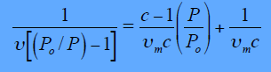
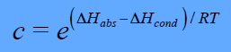
The Fundamental Equation of BET:
where P is the equilibrium pressure of the adsorbate (usually N₂) and P_{o} is the reference saturation pressure at the ambient temperature; ᶹ is the amount of adsorbed gas and ᶹ_{m} is the amount of physisorbed gas in the monolayer, both in terms of L
c is a constant relates the energies of adsorption (E_{abs}) and condensation (E_{cond})
Assumptions of BET
1. The surface energy is homogeneous
2. Only the top layers of the adsorbate are in equilibrium with the vapor (vertical interactions)
3. Lateral interactions of adsorbate condensate are not considered

Slide 54
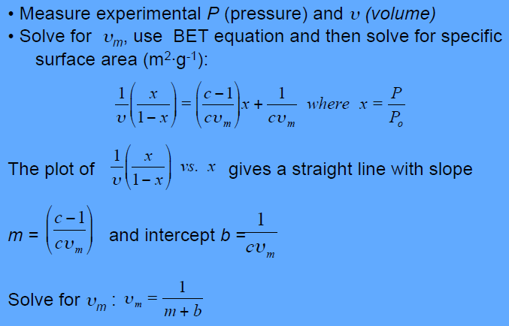
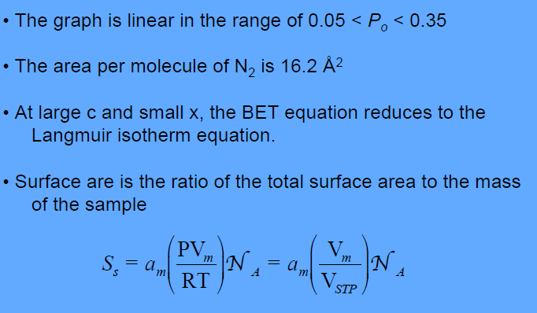

Slide 55
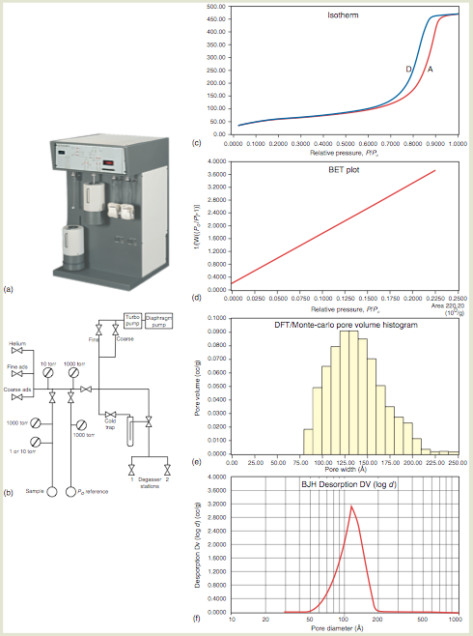
BET isotherm (with porosity and Hysteresis) with its extracted BET line. The specific surface area was
determined by the amount of adsorbate per monolayer.
BJH (Barnett-Joyner- Halenda) and DFT (density functional theory) analysis yields information about
pore volume and pore size. An Autosorb-I Series surface area analyzer manufactured by Quantachrome Instruments is depicted.

